Slide 1
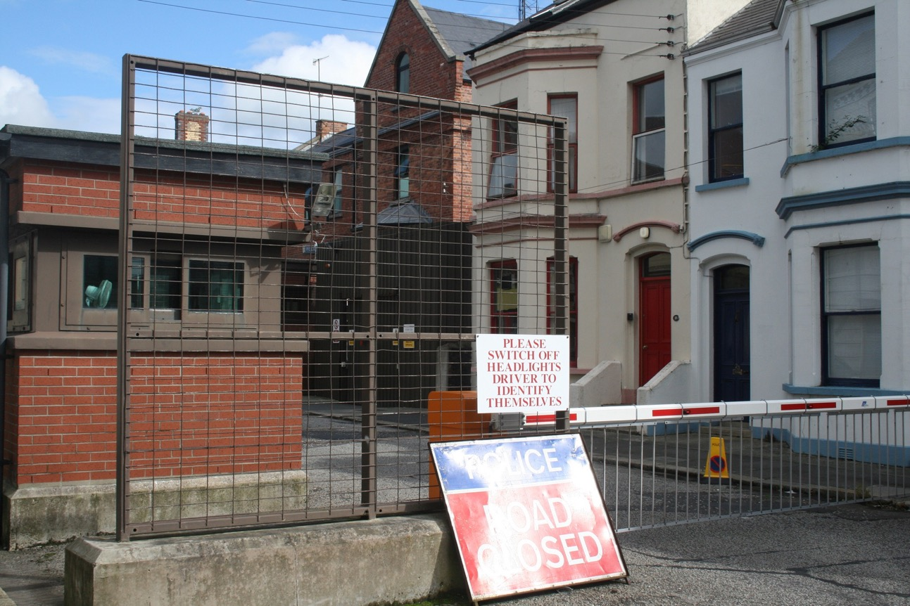
Household INFOSEC in a Post-Sony Era
Steve Loughran
stevel@apache.org

Slide 2

Notes:
This title comes about after the dramatic Sony hack. They got completely 0wned: deep attack, massive lift of sensitive data, and exploited to maximum effect.
Afterwards everyone in security condemned them: "where was their defence in depth?" "how didn't they detect this?", etc. etc.
I felt this was too critical, and chose a different attack: could I secure my own house. And if I couldn't, I didn't have the right to criticise Sony.

Slide 3
Data Integrity
Data Privacy
Data Availability
Resource Control
Notes:
What do I actually want to do? Generally: keep my data mine, and accessible to me on demand.
Secondary: keep my computing infrastructure only running code of my choice (not bitcoing mining, a teenage boy after his bedtime hours, etc).

Slide 4


Don’t upset a nation state
Notes:
First lesson of the Sony affair: Don’t upset a nation state. Not only do they have capabilities you are utterly unprepared to deal with, a few of them appear to have loosely-affiliated "patriotic" hacker groups that you also don't stand a chance with. Then there's Anonymous. They know what they are doing too.

Slide 5
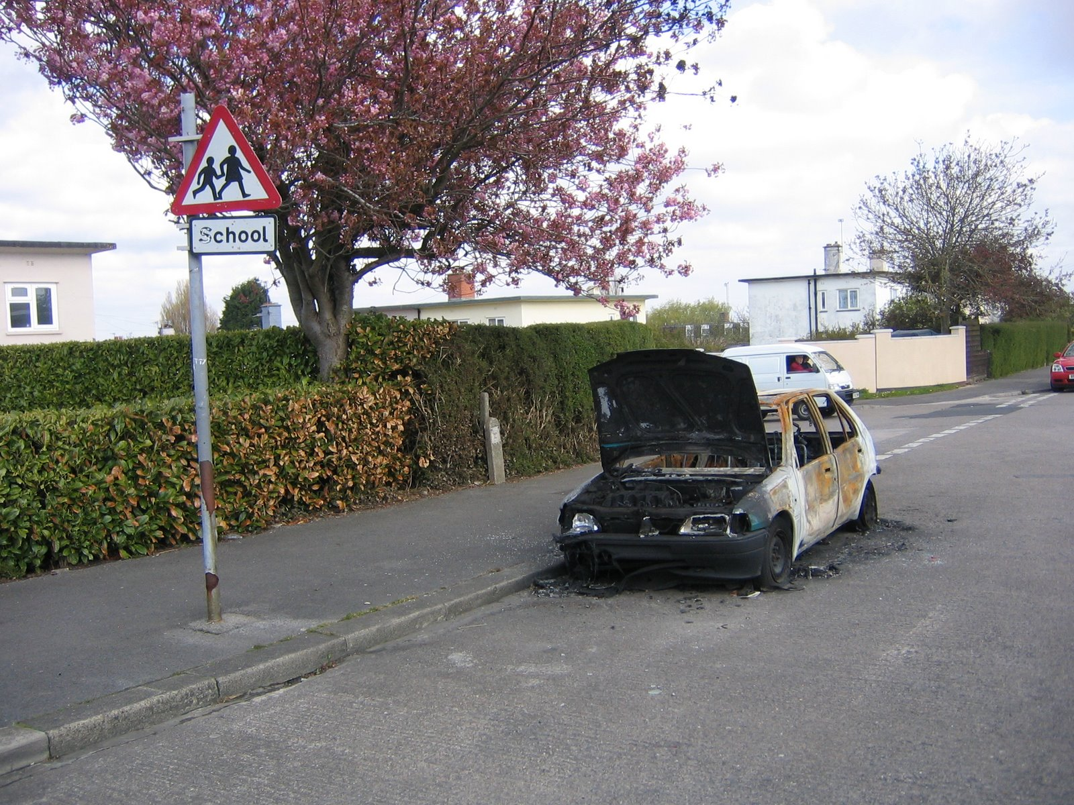
Worry about drive-by
Notes:
Drive by malware: this is something you can think of defending against

Slide 6
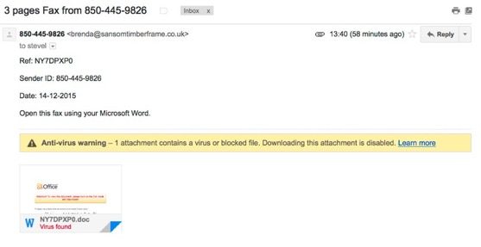
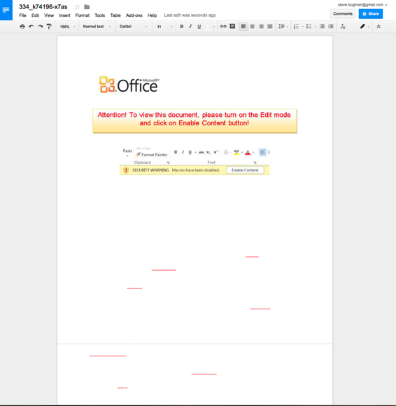
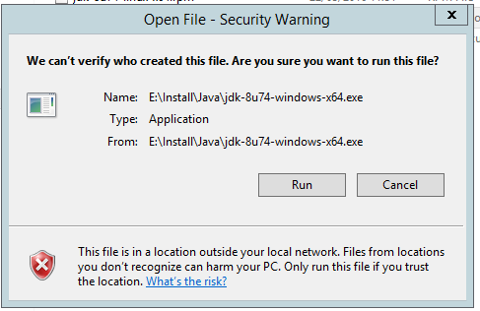
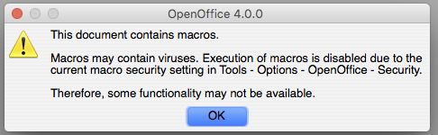
Notes:
I could just go through the classic "never download a binary", "never open a word doc with macros", or ""emails with faxes in", but that is stuff that should be well known. What I want to consider is something more fundamental.

Slide 7
How to Quantify Risk?
Privacy (lack of)
Vulnerability
Notes:
Let's drop this notion of a secure vs insecure system, that of any software having "vulnerabilities". We need to recognise that all our code contains vulnerabilities. All that matters there is: how exploitable are the vulnerabilities? Is being on the net enough? Browsing a page with a malicious ad? Opening an email? Or is it more convoluted?
Equally importantly is the concept of "how much information does my system leak by design?. If I want to keep my data private, I should be considering how much data gets collected by external parties, what they deliberately do with it —and what could be done if they themselves were breached?

Slide 8
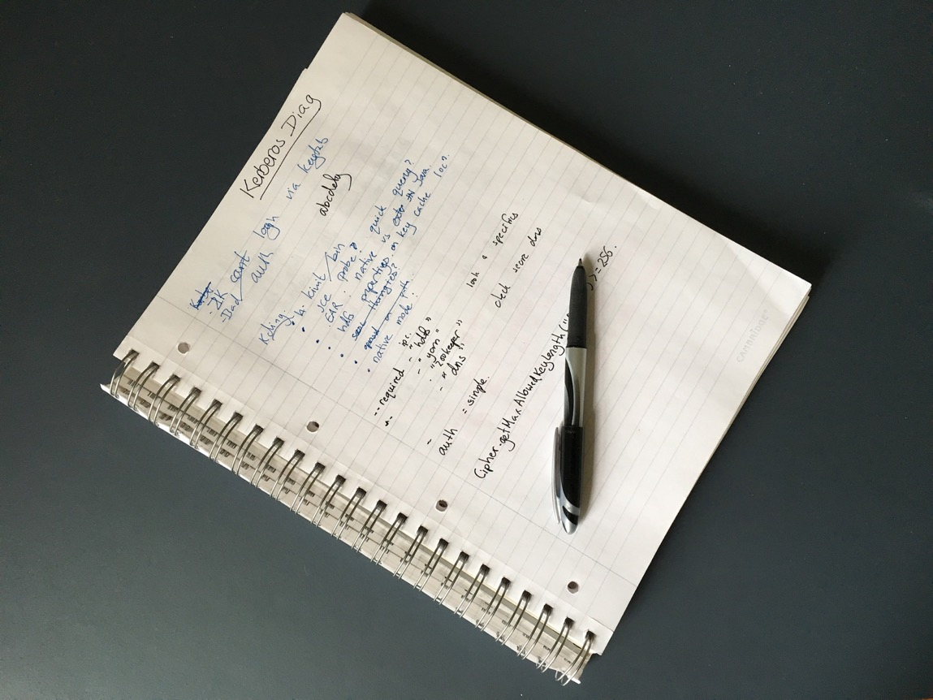
(1, 0)
Notes:
This is the best we can hope for; pen and paper. All data is local; nothing leaks unless someone has physical access. Do note: no DR strategy unless you duplicate the docs and keep a set off-prem. That's exactly the strategy executed by monasteries for the centuries prior to the printing press

Slide 9
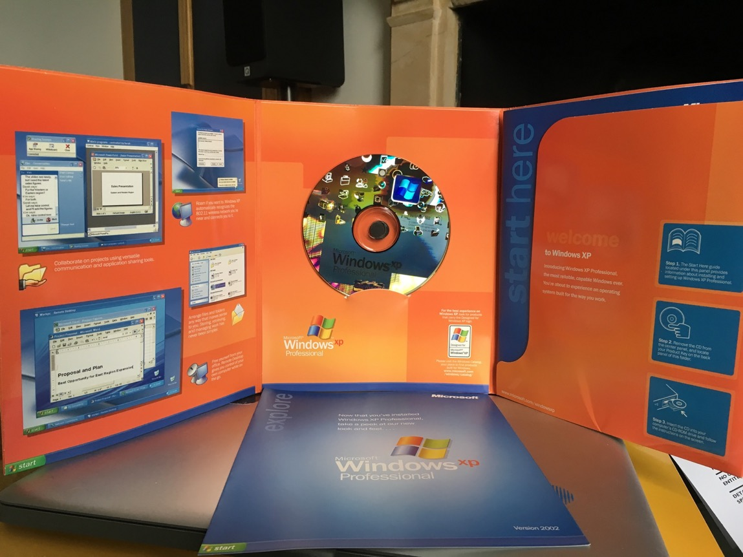
(11, 1)
Notes:
And this is as insecure as you can get: Windows XP retail. Something that is so vulnerable that you could never bring it up on the internet, Even before vista at HPLabs our IT dept had a separate isolated subnet where they could bring up a system to date with service packs. Nowadays: not a chance. Let only last month I was paying for drinks at a pub whose Till's screen saver said "windows XP embedded". Once embedded, it takes a long time to go away: we can only hope for total network isolation.

Slide 10
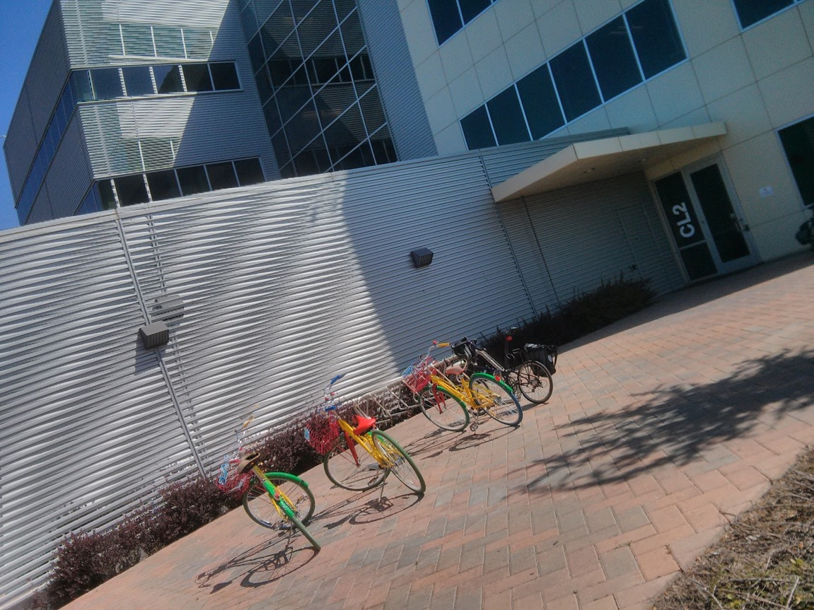
(*, 11)
Notes:
On the privacy scale: google. The only thing worse than google would be a google/FB merger with everyone wearing android watches uploading health data to google. We have to be grateful that google+ failed, that not even google could afford to buy FB, and android watches are yet to take off.

Slide 11
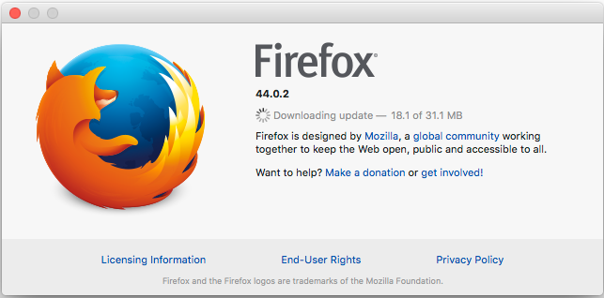
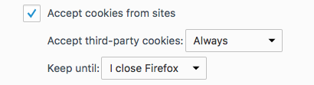
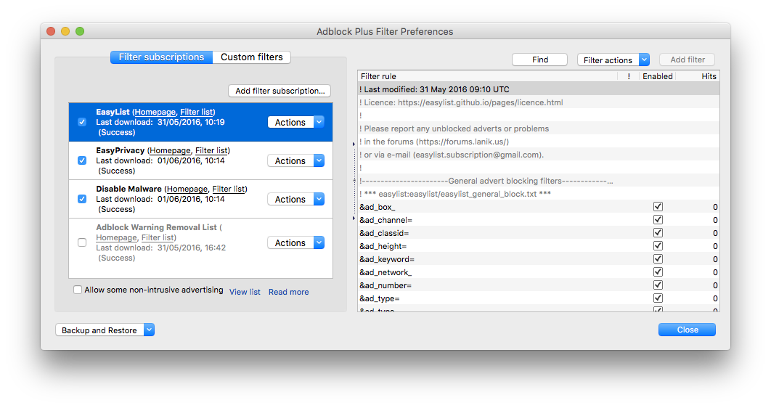
Firefox (8, 2)
Notes:
Browsers: key attack vector of drivebys, especially advertising funded malware.
Firefox is good, though you do need to keep it up to date. And install adblockers & set all cookies to go.

Slide 12
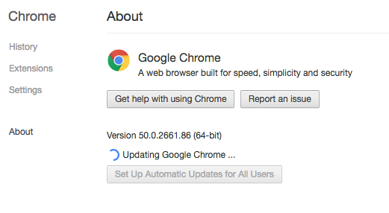
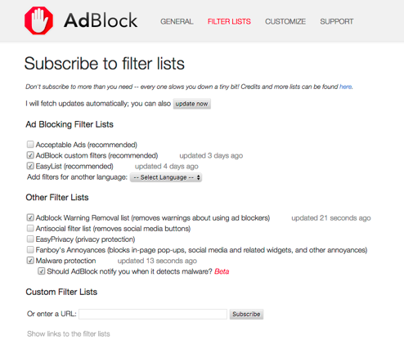
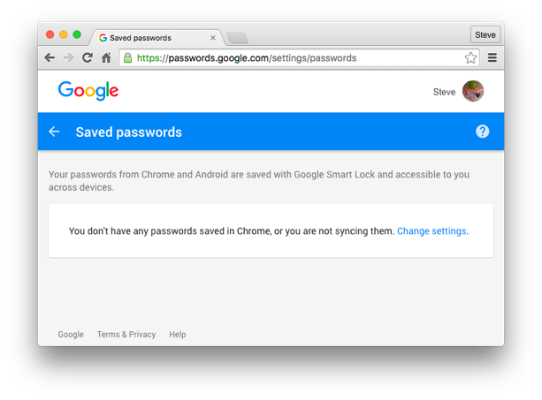
Chrome: (8, 10)
Notes:
If you want to know why I rate chrome so bad in privacy: hook up wireshark and see how it's continually chatting to google, at least when "logged in".
And if you aren't logged in, things don't work, including the chrome app store.
Key: make sure your passwords aren't being saved to the google password site. To avoid that you need to turn off “smart” logins on your android phone. Yes indeedy.

Slide 13
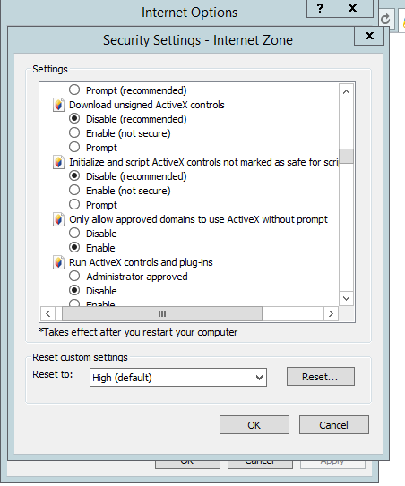
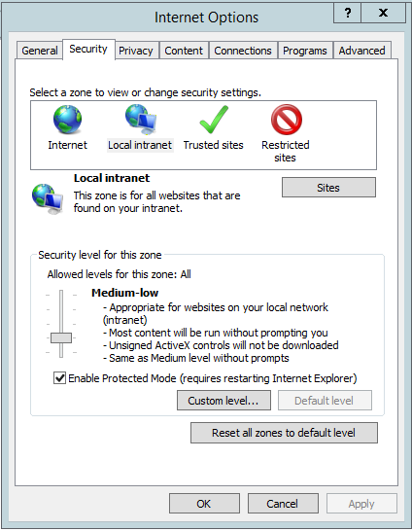
IE 11 Use to D/L Firefox or Chrome
Notes:
IE just avoid. ActiveX was a mistake, but it's compounded by a security configuration model that is near-impossible for the uneducated to lock down, and way too trusting. It should only be used when you first boot a machine, to update to your choice of chrome or Firefox.
If for some reason you really have to use it, such as you have to use some in-enterprise expenses program, go through the security zones and crank everything up. Don't trust intranet more than internet, "trusted" sites should go to medium with extra restrictions on ActiveX, and add that expenses site to trusted if is the only thing you need to go near.

Slide 14
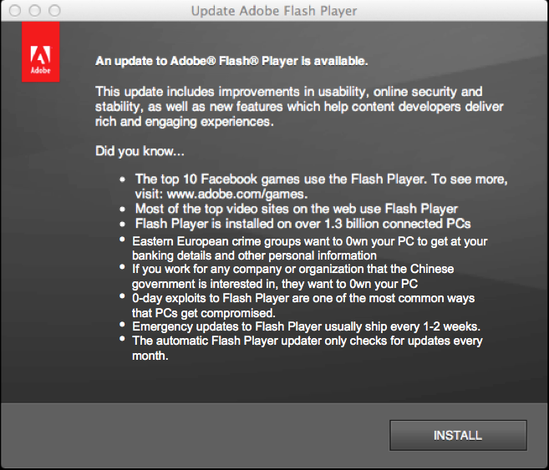

Flash (9->10, 4)
Notes:
Flash's public vulnerability follows a saw wave, with a frequency of ~2 weeks —the monthly update plus the mid-month emergency patch. The update checker only appears to check for those monthly patches, so is essentially worthless.
Test for your defences working: you can't view donald trump videos on BBC web sites

Slide 15
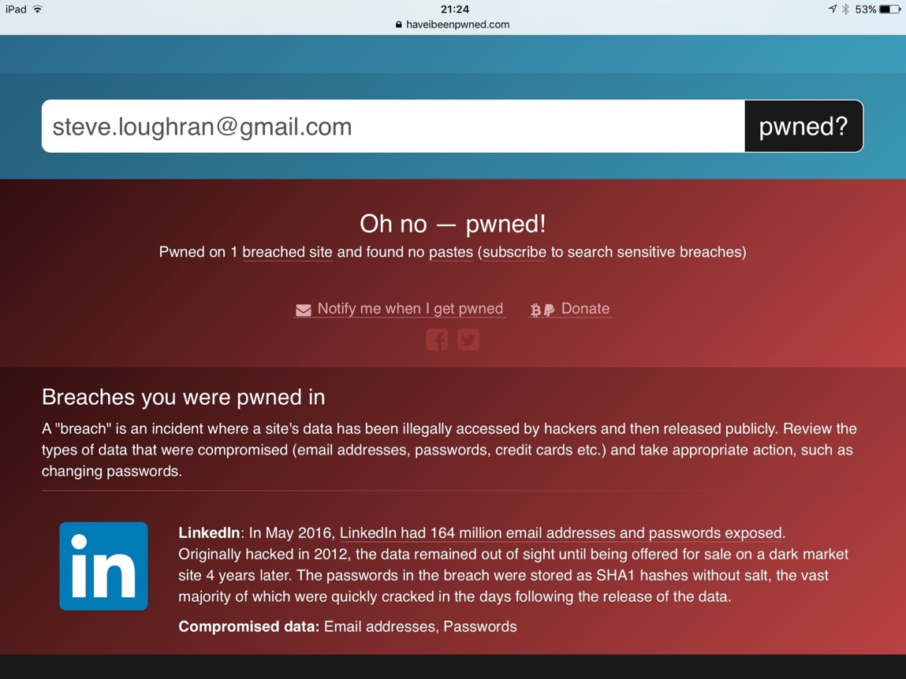
Notes:
It's worth noting that all this is moot if the information you provide to a web site gets leaked. This is why you need to control what data you publish, and hope that the people whose web sites you use know foundational security, such as "salt your hashes", and, ideally, a hash algorithm that can't be accelerated in GPUs. I'd also say: allow for 15+ letter passwords, unlike, say MS live.

Slide 16
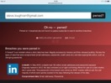
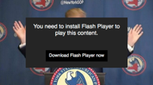


Privacy (lack of)
Vulnerability
Notes:
Where does this stand? We pretty much have to put everything at the high end of the vulnerable scale, the only variation being: how far, or more likely, "what is the mean time in days between updates and exploits being out in the field". I'm ignoring nation states and affiliates here: they'll have a pool of 0-days waiting to be deployed as required.
Defence: uninstall everything you don't really need, keep what you have up to date. Say no to flash.

Slide 17
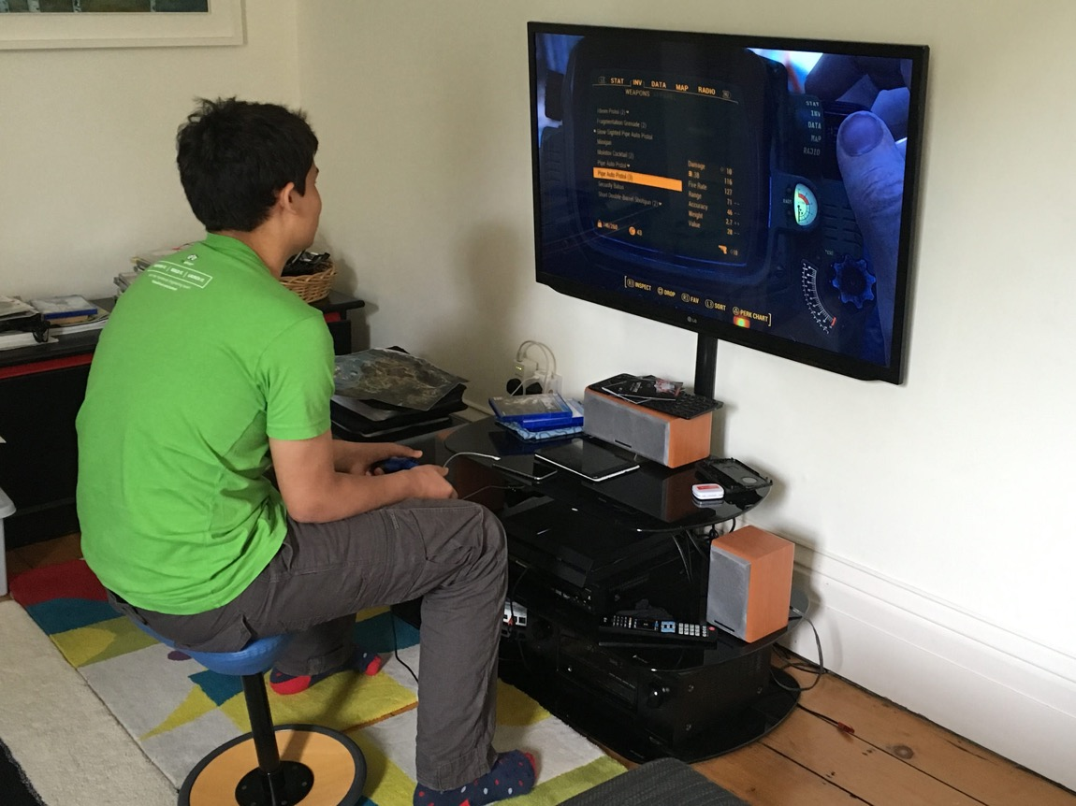
trouble—
—LG TV
iPad—
—iPhone
—PS4
-Airplay Amplifier
Notes:
But the world os changing, and this is where it goes from "hard" to impossible.
Here is a non-staged photo of my 14 year old son. Video game on the PS4, a PS4 logged in to the Sony PS4 network (remember them?). Wired through an LG Smart TV and an amplifier that supports AirPlay, so is also on the LAN. He's got an iPad mini playing a youtube video, and his phone has snapchat running so his friends can talk to him. I have no access to those devices —and yet they are on my net.

Slide 18
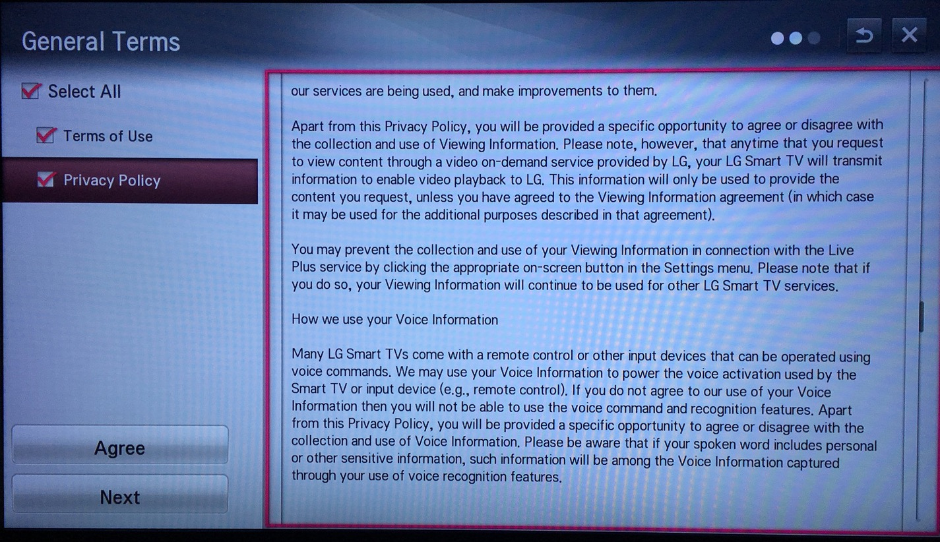
LG TV
(?, 8)

Slide 19
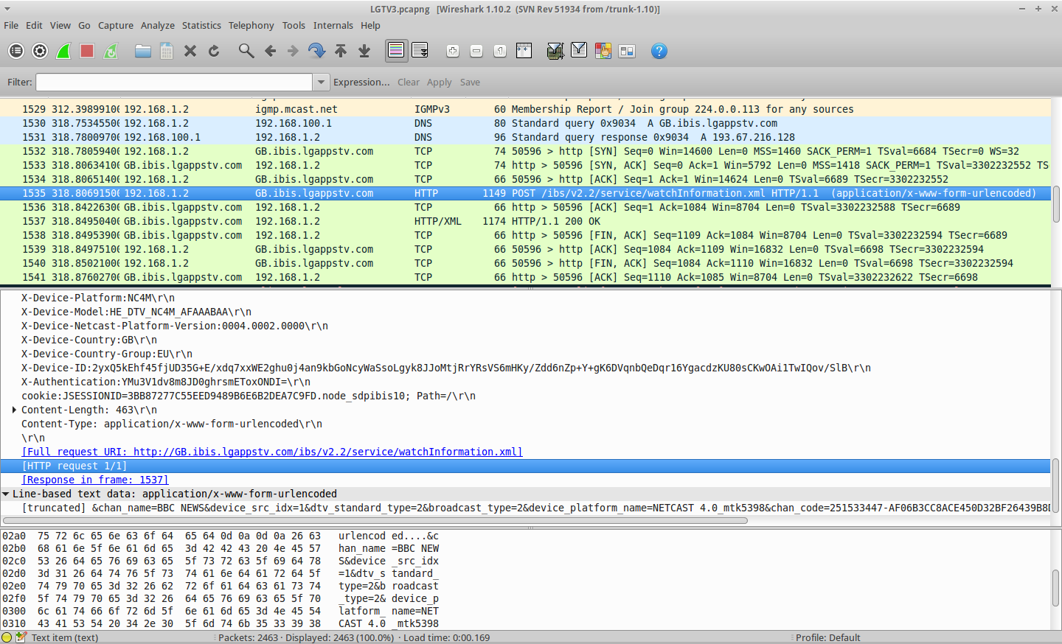
doctorbeet.blogspot.co.uk
(?,10)
Notes:
A special mention here of the TV. Other LG TVs were shown via wireshark to be sending unencrypted packets up to LG's non-EU sites logging what over-the-air channels you were watching. After going to a lot of effort to be able to wireshark to an ether-cabled TV (tip: keep a slow hub around as well as the switches), I found I was lucky. But LG did forcibly change their T&Cs to say "We can do this, record what you say, sample content over the HDMI port, and take this abroad. Kids shouldn't use the TV"

Slide 20
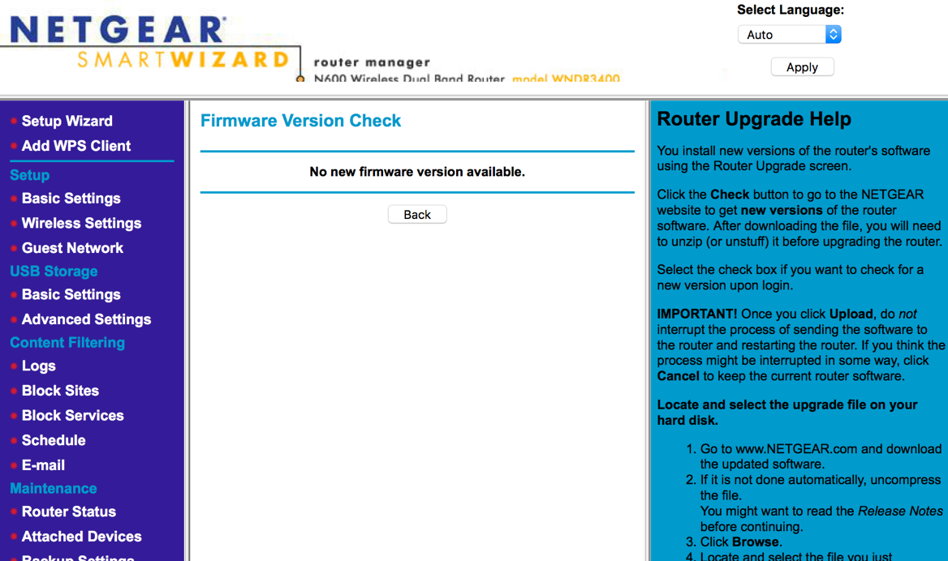
(?, 0)
Notes:
All this is behind a firewall that doesn't have updates. Even after all the years of known attacks, updates don't come out. Why? There's no money in the vendors for it, and people buy for bandwidth and features, not security.
I tried to switch to DD-WRT for this, but had mixed success; PPPoE daemons wouldn't start, and without that, while I could bring up the router, I couldn't get on the internet. I was also intimidated by how complex the DD-WRT options are: I'd have to do lot of portscanning to convince myself it was good. Even so, it appeals to me: VPN options without doing things with a Pi; log generation that I could feed to a TSDB, control

Slide 21
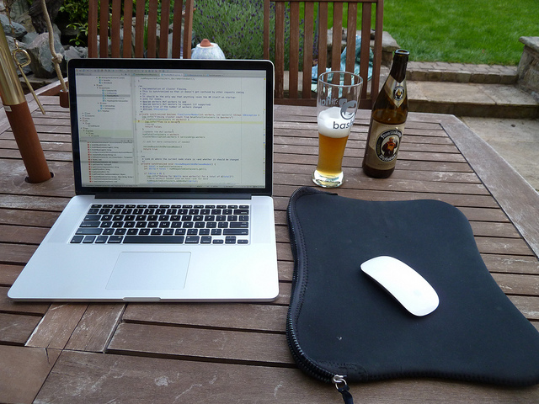
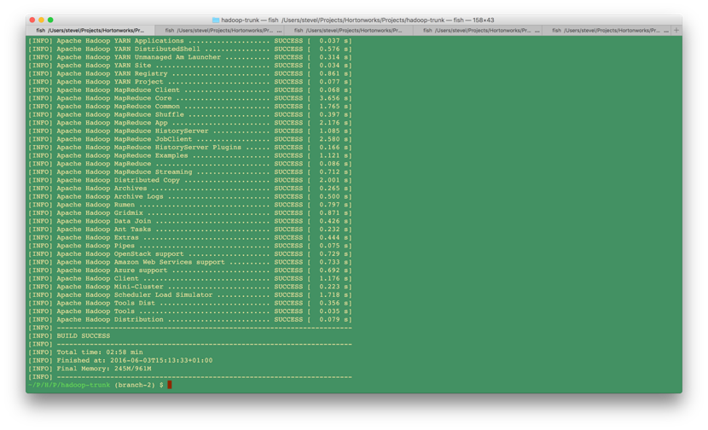
Notes:
I should add at this point that I work from home on Hadoop, Spark and related things.

Slide 22

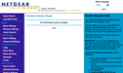
Privacy (lack of)
Vulnerability
Notes:
This is what I have in the house then. A collection of things of various known and unknown vulnerabilities. What to do?

Slide 23
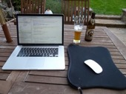
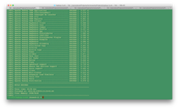

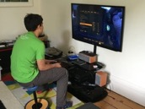

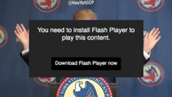
CRITICAL
USB
DD-WRT
...
DMZ
New Netgear Firewall
Notes:
This is what I've done, be interested to see how it works out.
I've partitioned net into "where I work", "critical infrastructure", and a zone of less trust
I gave up on DD-WRT+my existing hub as the internet firewall. I've pulled that up between critical and a new DMZ
That's hooked up to a new netgear FW I bought. That's still running the retail firmware; I'm bringing myself up to play with trying to get DD-WRT up on it.
The DMZ has all the consumer stuff, a laptop running a DLNA server and bittorrent, the latter so that I can stop my son trying to browse to sites he shouldn't and so that I can impose a hint of ethics there "it must have been on terrestial TV or we could get it on netflix if I VPNed somewhere"
The critical infra has access to the DMZ.
Issues: where to put a home imac? Or my wife's laptop? What about my own tablet and phone (table -> DMZ; phone -> Critical)

Slide 24
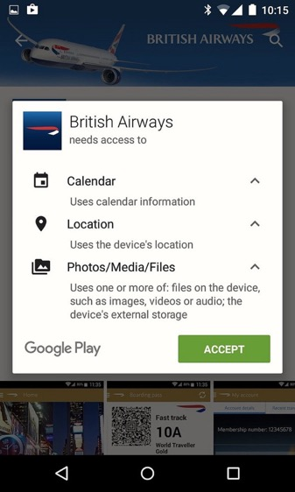
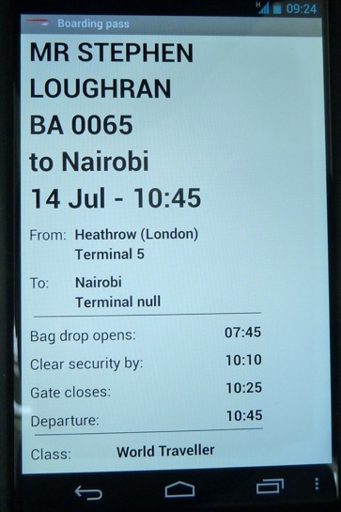
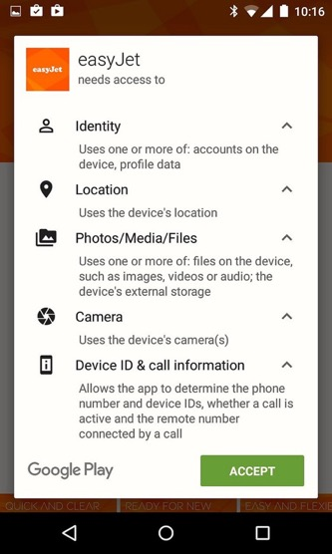
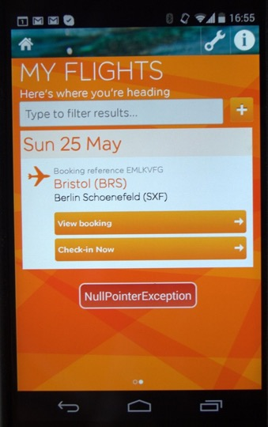
Other?
SQL vulnerability?
(?, 11)
Notes:
But is it enough? Not now we all have a smart phone in the house. Because even to do something as fundamental as "get a boarding pass", I need to install android apps which explicitly demand access to things my calendar and call info: deeply private.
And even if you trust these people to not abuse the data, you can't rely on them to be infallible code wise. Here we have the BA App saying we're arriving at "terminal null, Nairobi". That says to me: weak validation of SQL responses from the server. Which says to me: hello, SQL injection.
As for easyjet, that's an NPE there.
And these devices are non the net, potentially with open sockets. That's public 3G/4G net, not even my home-firewall-protected DMZ

Slide 25
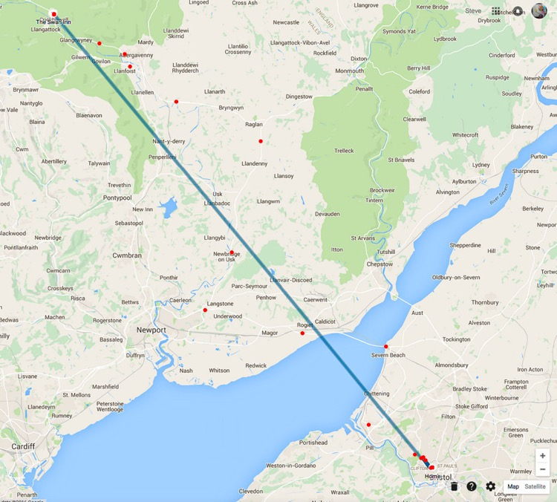
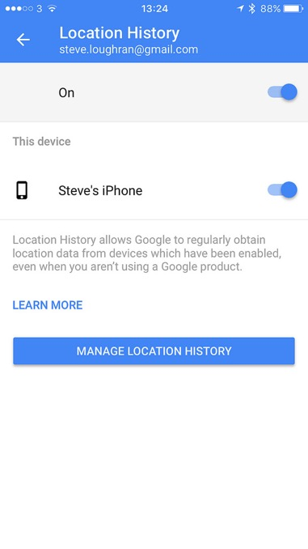
iPhone + Google photos
(5,11)
Notes:
One action I did here was go from android to iphone; whereas android forces you to accept an app author's demands if you want to do something as simple as online checkin, at least iphone lets you turn it off for apps.
But you had better do it. While researching this talk, I wanted to show how the google/location history used to track my movements, but since I went to iphone it had stopped. Only then did I discover I was still being tracked. I was actually worried that they were working out from the IPAddress of gmail mail polls over SMTP, but eventually tracked it down to google photos. In order to "improve your photo experience", it tracks you, and that tracking goes into the general "Google tracks you" event soup.
Fix: disable.

Slide 26
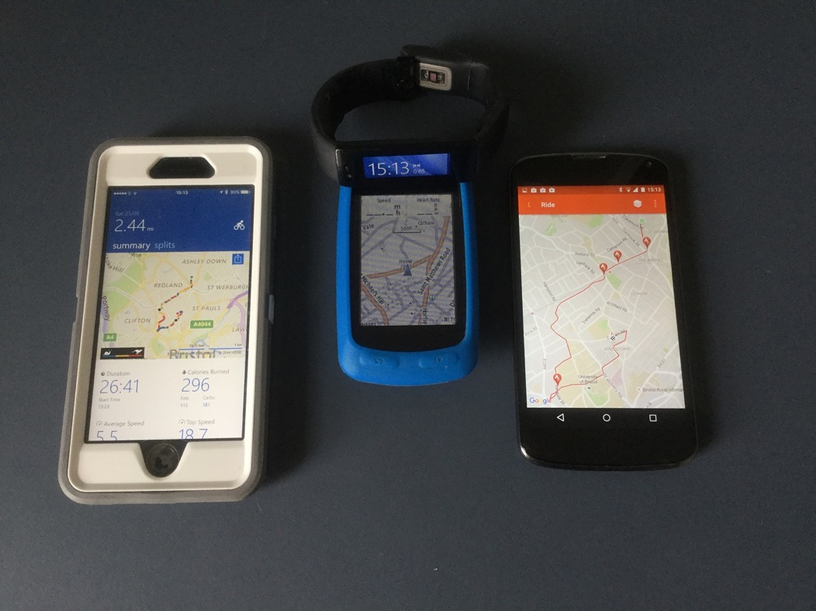
(3,11)
Notes:
Also note that I'm wearing a MS Band fitness tracker, did a bike ride last week with a garmin bike computer, Both of these upload location data (MS, garmin), and then to strava. That's more intimate location data than google photos, and the MS Band even tracks my exercise, heartbeat, walking and sleeping history 7x24. At least here I get tangible ROI. Not only can I track my exercise on Strava, that heartbeat stuff is handy to talk to when I go to my doctor to discuss those anomalies which we Glaswegians fear. And Strava has a notion of "privacy zones", where for others your ride is kept private.
In contrast, Google photos gives me automatic photo albums, and LG TV gives me nothing at all
If we users are to provide personal data to web sites, they need security we can trust, give us something in exchange, and privacy.

Slide 27

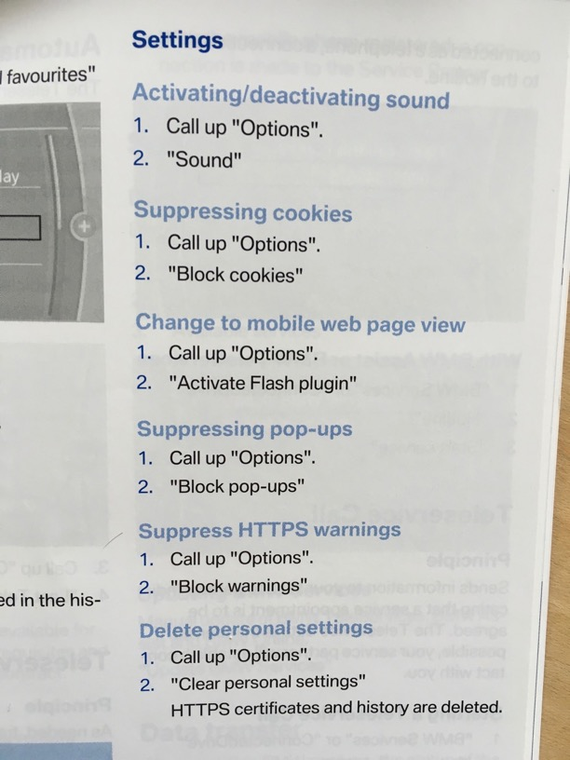
( ?, >7)
(9, >7)
Notes:
Then we bought a car, a second hand german one
I wanted to do a full download of the vehicle history: see how ratio of manual:automatic use, how often the ABS or traction control went on, other cues about how it had been previously driven. Apparently all that stuff is there. I live in a hilly city: I believe that data about speed and accelerations should be enough to identify roads and where I live. Do you want to share that data? And if you buy a car, given how informative it is: would you trust a vehicle whose previous owner had erased that history?
Anyway, we were very happy, and one day I sat down to read through the entire manual on the navigation/infotainment system. Where I came across instructions about how to disable flash. That's flash as in "emergency patch every 2 weeks flash", now shipping embedded in cars that get served once a year.
Fortunately, a panic check of our car settings menus showed that we didn't have flash, the previous owner hadn't paid for the premium "web" edition. But WTF?
After a large crash we had to replace the car. This time I made sure it didn't come with flash.

Slide 28

Game over
Notes:
The car will be the new battleground for Infosec, the Jeep fiasco in the US showed that not only can infotainment consoles be owned remotely, the transmission doesn't have an iptables equivalent, rejecting gear change instructions from the hifi. These people utterly out of their depth.
We've lost. There is nothing I can do about locking down my house when cars are shipping with flash, my phone connects with the car, it also talks to my laptop, runs checkin apps that don’t validate SQL responses, while connected to web sites that don't even salt their password hashes.

Slide 29



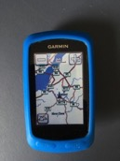
Privacy (lack of)
Vulnerability
Notes:
This then is my final approximate world view. We are utterly out of our depth.

Slide 30
We must fix this in our code
Notes:
The way to fix this is is before it gets in the hand of the consumers, in the code we write,
We are the only people who can do this —and as we have the ability, we have the responsibility.
It's us or a world with flash in cars, channel sniffing televisions, and phone apps with SQL parsing

Slide 31
All external data is malicious
All remote interactions leak privacy
Notes:
Assume all data is malicious, has come from an untrusted source. Not naïve trusting of offsets in data structures, treat all payloads as potential attacks
And view all interactions with remote systems as leaking data. You have to decide from the level of your app what data leakage is acceptable to your end users, and give them something in exchange.

Slide 32

C
C++
Notes:
Say no to stack buffer attacks.
Most interesting to me right now: Rustlang. Because it's faster than JVM code, no GC pauses, and being pushed by Mozilla as the language for plugins, including codecs.
Also: community-centric dev proxess. Erlang also has that; Java doesn't, Scala is adding C++ features and collection libraries that are more PhD projects than usable tools. Go-lang? Experiences with Google guava &c don't convince me that they care enough about external users.

Slide 33
new URL(“http://www.starcon.net.kp”)
.toString()
java.net.URL (>2, >2)
Notes:
Example 1: what happens here?
Answer: DNS lookup to north korean govt site, response goes all the way to the critical infrastructure. You could say “avoid by not looking up this URL” —but what if it’s part of your clicklog analysis? Someone malicious just needs to hit your site and then you’d be doing this in your server. Fix: java.net.URI

Slide 34
def objectFile[T: ClassTag](
path: String,
minPartitions: Int): RDD[T] = withScope {
sequenceFile(path,
classOf[NullWritable],
classOf[BytesWritable], minPartitions)
.flatMap(x =>
Utils.deserialize[Array[T]](
x._2.getBytes,
Utils.getContextOrSparkClassLoader))
}
SparkContext (0, 9)
Notes:
Example 2: what's gone wrong here?
Answer: deserializing java objects, no validation of desered state. If you have groovy on your CP, you can deser groovy closures, which will be executed in the process.
Thus, if someone can persuade you to use their data as a source in your spark code, they get to run code as you in your hadoop cluster. Is that what you wanted?
Oh, and spark 1.6.0 has a vulnerable version of groovy in spark-assembly.jar, meaning this vulnerability is built in. I fixed it in 1.6.1

Slide 35
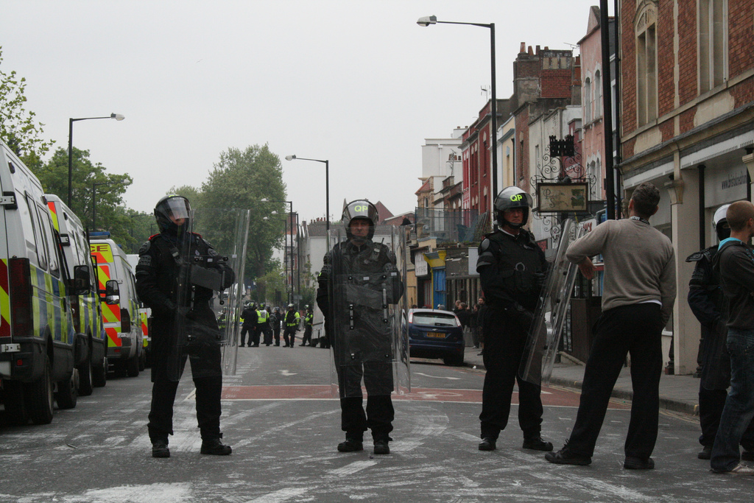
OSS everywhere ==> target
Notes:
Coming back to governments: dissenting from the currently elected one is a fundamental right of a democracy; disagreeing with some of the actions of foreign governments equally defensible

Slide 36
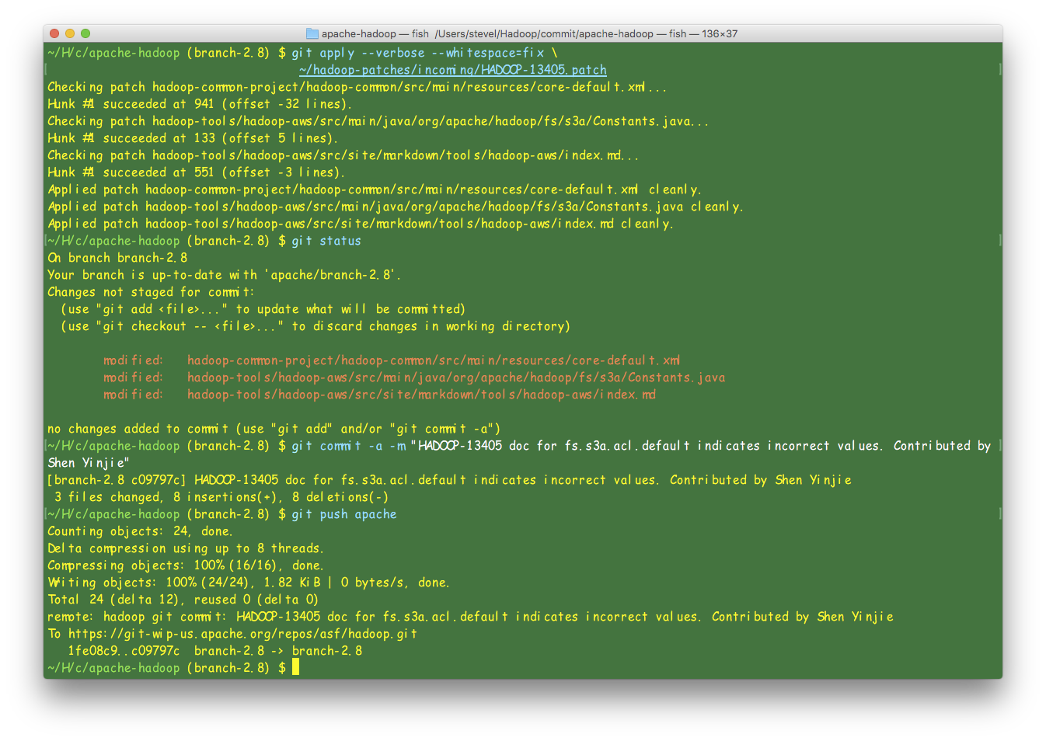
Apache & github keys
Notes:
As

Slide 37
build dependencies
apt-get upgrade
brew upgrade
mvn install
npm update
yum update
pip install
docker pull
…
We need to address this!
(?,?)
Notes:
One person in our house downloads applications on a regular basis. That's me. And yet I'm the one whose credentials have to be considered important beyond just our household. I'm relying on the competence and honesty of the entire developer chain. Should I? Can I? Alternatively: how would you compartmentalise your development systems so that your core secrets are not in the same VM/container in which you are developing?

Slide 38
Isolation: containers?
Authentication: PGP validate mvn…
Audit logs
Notes:
We should isolate bits of the build more. I do this for windows work; a VM with read only access to the ASF repo; no access to host FS (though shared clipboard). Can we do this for the entire dev environment?
Maven/Ivy just do checksum validation. We should publish artifacts with .ASC signatures and check them on D/L.
+ save a history of all downloads in audit logs which can be post-processed. Some standard format across tooling will help here

Slide 39

Questions?
Notes:
Finally, never trust a USB bike light you pick up a conference.

